Slide 1
PowerPoint Presentation
Of Project
On
“GoLive”
Submitted by:-
Shobhit Jaiswal Swaraj Kumar Gupta
Roll No.-1130211197 Roll No.-1130211219
BCA 3rd Year

Slide 2
Introduction
A Web Host is in the business of providing server space, Web services and file maintenance for Web sites.
It can be controlled by individual or companies that do not have their own Web servers.
If we have to publish a web page we have to go to the sites/provider that provide us server space. Since a user that want to publish his/her web page visit these sites and check which is suitable for his/her web page. In this, user will suffer loss. To overcome this limitation we have an idea of GOLIVE.
GOLIVE is based on idea of comparing these web host on bases the fee that they charge and amount of space providing on server.
GOLIVE we will make comparison of the web host provider which include fee that they charge, bandwidth size, space providing on server and domain name that they will provide user.

Slide 3
Advantages…
Time Saving.
Many host provider service plan on one page.
User will not have to suffer from loss.
Reviews of old user will be available for new user.
User don’t have to go here and there to choose correct plan.

Slide 4
Objective…
We will provide user a comparison list of web hosting sites on the basic of fee, server space, bandwidth and domain name. We will also provide reviews of old user’s which are using that web hosting services.
Scope…
Now a days many web pages published by user. If any user want to publish their web page they just have to check our site and will get best host provider for their web page. It can we used by any user throughout the world who want to publish their web page.

Slide 5
Modules Used
Shobhit Jaiswal
User Management
Pricing System
Notification System
Search System
Dashboard
Swaraj Kumar Gupta
Domain And Hosting Services
Review And Rating
Feedback System
Vendor Management
Security System

Slide 6
Problem Statement
If we have to publish a web page we have to go to the sites/provider that provide us server space.
Since a user that want to publish his/her web page visit these sites and check which is suitable for his/her web page.
After that he/she will buy their plan of publishing web page. This process take time and user effort and in some case money too.
Suppose after buying a plan for a web host, the user know that there are some web host provider that allow user to publish web pages in less cost. In this user will suffer loss.
To overcome this limitation we have an idea of GOLIVE. GOLIVE is based on idea of comparing these web host on bases the fee that they charge and amount of space providing on server.
In the GO LIVE we will make comparison of the web host provider which include fee that they charge, bandwidth size, space proving on server and domain name that they will provide user.

Slide 7
Requirement Analysis
In our Website, Many Vendors have add or update their web hosting plans and services they provided on the single platform. In this website, the User gets a comparison list of services provided by different vendors and selects a plan who suits his needs. The whole process is undertaken by Admin of the website. The user and vendor on the website is need to be able to:
Make registration to our website then they receives a unique User ID and Password.
Log in to the system by using user id and password provided to it.
The vendor adds or update his plans list.
The user have to search for plans and buy it directly from the vendor’s website.
Both of us have log out from the system.

Slide 8
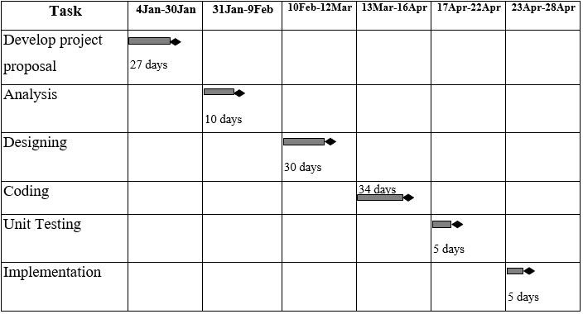
Gantt Chart

Slide 9
Software Requirement Specification(SRS)
Purpose:-
This Software Requirements Specification (SRS) specifies the requirements of the GoLive, which will be used in internet which provides user a comparison list of web hosting plans and space provided on server on the basis of fees, bandwidth range & domain names. This document will be useful for the users to ensure all specifications and requirements are conducive as mentioned by the software engineer to design the system.
Project Scope:-
Now a days many web pages published by user. If any user want to publish their web page they just have to check our site and will get best host provider for their web page. It can we used by any user throughout the world who want to publish their web page.

Slide 10
Product Features
In our website, the user can get a comparison list of services provided by different vendors on a single platform.
The user gets notified when vendor adds or update a new plan.
User don’t have to go here and there to choose for correct plan.
We will also provide reviews of old user’s which are using that web hosting services.
Time Saving Mechanism of website keeps user comfortable to website.

Slide 11
Hardware and Software Requirements
Hardware Requirements:-
Client Side
Processor : Dual core or above
RAM : 1 GB
Disk space : 500 GB
Monitor : 15 inch colour
Printer : Depend on user
Keyboard : 108 Key Normal
Mouse : 3 Button Normal Mouse
Server Side
Processor : Dual core or above
RAM : 1 GB
Disk space : 500 GB
Monitor : 15 inch colour
Keyboard : 108 Key Normal
Mouse : 3 Button Normal
Software Requirements:-
Client side
Internet explorer or Google chrome
Windows XP or above
MS office.
Server side
Internet explorer or Google chrome
Windows 7 or above
MS Visual studio 2015.
MS SQL Server 2014.

Slide 12
Data Flow Diagrams
Overview
Data flow diagram (DFD) represents the flows of data between different processes in a business. It is a graphical technique that depicts information flow and the transforms that are applied as data move form input to output. It provides a simple, intuitive method for describing business processes without focusing on the details of computer systems. DFDs are attractive technique because they provide what users do rather than what computers do.
Level 0 DFD:-
Level 0 DFD must balance with the context diagram it describes.
Input going into a process are different from outputs leaving the process.
Data stores are first shown at this level.
Level 1 DFD:-
Level 1 DFD must balance with the Level 0 it describes.
Input going into a process are different from outputs leaving the process.
Continue to show data stores.

Slide 13
Level 2 DFD:-
The level of detail. The Level 1 shows the whole system. Level 2 focus more closely on one particular process in the level 1.
Relationship and Rules:-
Relationship
The DFD may be used for any level of data abstraction. DFD can be partitioned into levels. Each level has more information flow and data functional details than the previous level.
Highest level is Context Diagram. Some important points are:
1 bubble (process) represents the entire system.
Data arrows show input and output.
Data Stores NOT shown. They are within the system.
Rules
In DFDs, all arrows must be labeled.
The information flow continuity, that is all the input and the output to each refinement, must maintain the same in order to be able to produce a consistent system.

Slide 14
0’s (Context) Level
Data Flow Diagram

Slide 15
User
Credentials
Search Plans
Plans List
Feedback List
GoLive
Notification
Manage Users
Feedback
Admin
Review and Rating
View Users
Response
Manage Vendor URL
Feedback
Review And Rating List
View Plan List
Vendor
Credentials
New Plans
Update Plans
Response List

Slide 16
Level 1
Data Flow Diagram

Slide 17
3.0
Profile
D1
Notification
Notification
System
Updated Plans
D2
Vendor
User
Search Query
Hosting Plans Management
Hosting Plans
Plans List
2.0
D3
Response
Credentials
New Plans
Profile Management
1.0
Dashboard
D1
Profile
6.0
Update Plans
User List
Vendor List
Vendor
Plans List
D2
Credentials
Admin
Feedback List
Review & Rating System
4.0
Vendor
Response
Reviews And Rating List
D4
Review
Reviews And Rating
Feedback
Feedback System
5.0
Feedback
D5
Feedback

Slide 18
Level 2
Data Flow Diagram

Slide 19
User
User
Profile Management
1.1
User Credentials
D1
Profile
Response
Vendor Credentials
Vendor
Profile Management
1.2
Response
D2
Vendor
Vendor
Response
Login
System
1.3
Credentials
Credentials
Response

Slide 20
An Entity-Relationship
(ER) diagram

Slide 21
E-R Diagram
An entity-relationship diagram (ERD) is a graphical representation of an information system that shows the relationship between people, objects, places, concepts, or events within the system. An ERD is a data modeling technique that can help define business process and can be used as the foundation for a relational database.
Three main components of an ERD are the entities, which are objects or concepts that can have data stored about them, the relationship between those entities, and the cardinality, which defines that relationship in terms of numbers.
The three main cardinal relationships are:
One-to-one (1:1): For example, if each customer in a database is associated with one mailing address.
One-to-many (1:M): For example, a single customer might place an order for multiple products. The customer is associated with multiple entities, but all those entities have a single connection back to the same customer.
Many-to-many (M:M): For example, at a company where all call center agents work with multiple customers, each agent is associated with multiple customers, and multiple customers might also be associated with multiple agents.

Slide 22
Gives
Views
User Name
M
Review
M
M
Vendor
Email
Logo
ID
ID
Comments
Password
Views
Rating
New
Vendor Name
View
Views
M
Hosting Plans
M
Admin
1
Email
Hosting ID
1
Plans Details
Vendor ID
Profile
User Name
Password
Email
Gives
M
Views
M
Feedback
ID
Message
ID

Slide 23
Tools and Platform
This project is a web application that is developed in ASP.NET using C (#) as front end tool and having SQL Server 2014 as back end tool.
Features of ASP.NET(front end tool):-
ASP.NET is a web application framework to build dynamic websites, web application and web services.
ASP.NET is built on the Common Language Runtime (CLR) allowing programmers to write asp.net code using supported .NET language.
Automatic Handling of Post backs and Multiple Browsers
ASP.NET has built in navigation controls.
In ASP.NET many security controls are provided.
Features of MS SQL server 2014(back end tool):-
Policy-Based Management
Backup Compressions
Extending Data Compression in SQL Server 2014 with Fixed Length Data Types
SQL Server includes better compression features, which also helps in improving scalability.
Streamlined installations
Star Join Query Optimization

Slide 24
Future Scope
If we have to publish a web page we have to go to the sites/provider that provide us server space. Since a user that want to publish his/her web page visit these sites and check which is suitable for his/her web page. After that he/she will buy their plan of publishing web page. This process take time and user effort and in some case money too. Suppose after buying a plan for a web host, the user know that there are some web host provider that allow user to publish web pages in less cost. In this user will suffer loss. To overcome this limitation we have an idea of GOLIVE. GOLIVE is based on idea of comparing these web host on bases the fee that they charge and amount of space providing on server. In the GO LIVE we will make comparison of the web host provider which include fee that they charge, bandwidth size, space proving on server and domain name that they will provide user.

Slide 25
Database Descriptions
Our Database consists of 7 different tables connecting at different parts of our website.
Table Structures
1. User Profile Table
Name | Data Type
Id | int
UserName | Varchar(max)
FullName | Varchar(max)
E_mail | Varchar(max)
Password | Varchar(max)

Slide 26
2. Vendor Profile Table
Name | Data Type
Id | int
UserName | Varchar(max)
VendorName | Varchar(max)
E_mail | Varchar(max)
Password | Varchar(max)
Logo | Varchar(max)
LogoPath | Varchar(max)
Status | Varchar(max)

Slide 27
3. Feedback Table
Name | Data Type
Id | int
Name | Varchar(max)
E_mail | Varchar(max)
Usertype | Varchar(max)
Message | Varchar(max)

Slide 28
4. Login Table
Name | Data Type
Id | int
UserName | Varchar(max)
Password | Varchar(max)
5. Hosting Domains Table
Name | Data Type
Id | Int
DomainName | Varchar(max)
DomainPrice | Varchar(max)
VendorID | Int

Slide 29
6. Hosting Plans Table
Name | Data Type
Id | Int
Platform | Varchar(max)
VendorID | Int
PlanType | Varchar(max)
Website | Varchar(max)
SpaceSize | Varchar(max)
Email_size | Varchar(max)
Ftp_size | Varchar(max)
PlanPrice | Varchar(max)

Slide 30
Website Screenshots
User Interface design

Slide 31
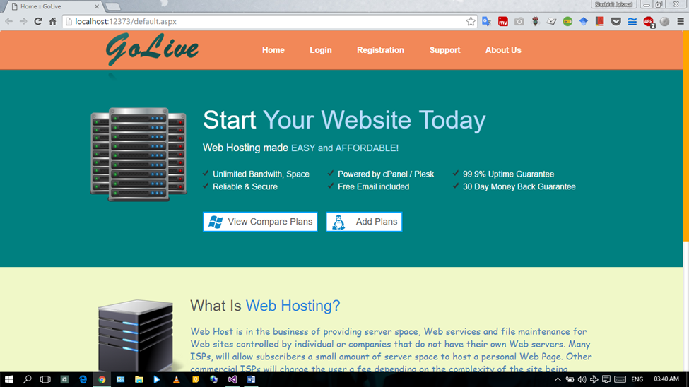
Home Page of our Website:-

Slide 32
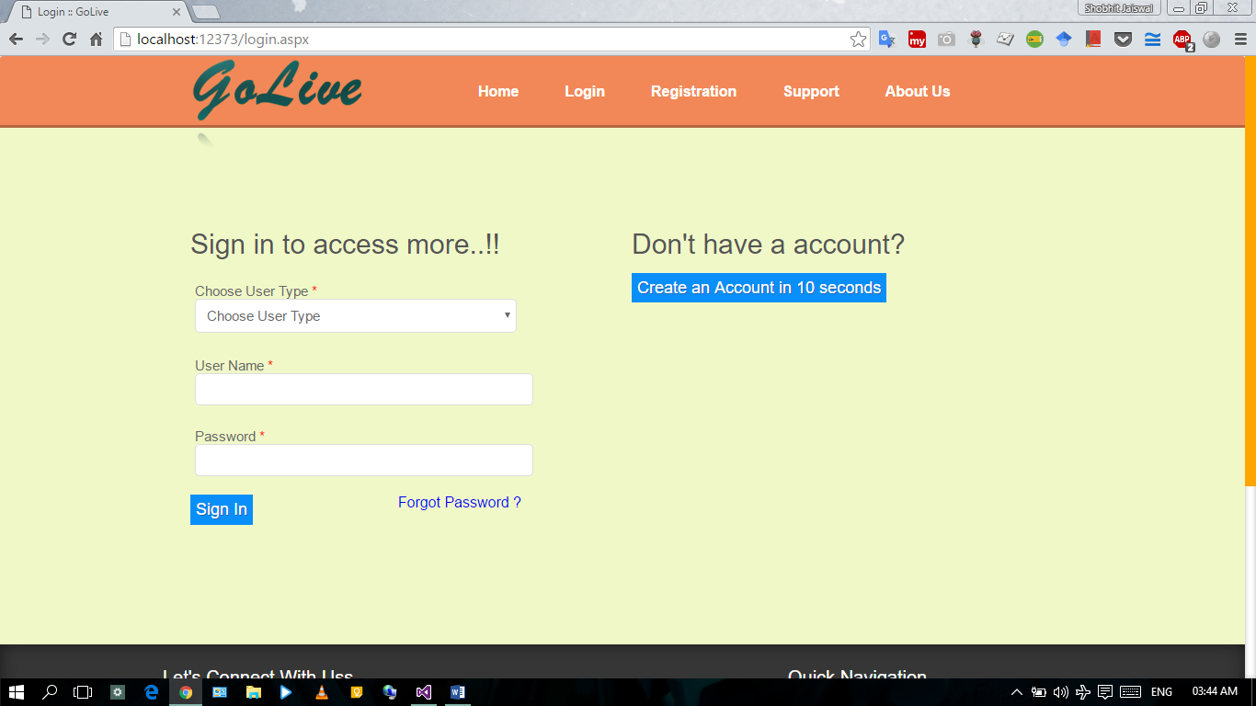
Website’s Login Page:-

Slide 33
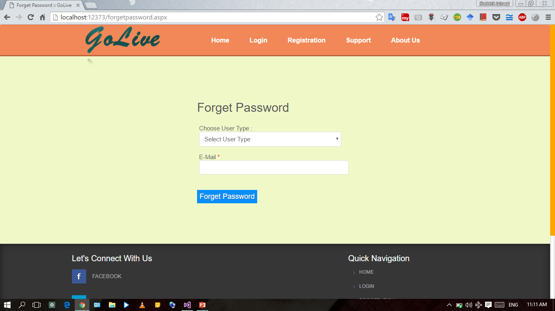
Website’s Forget Password Page for All:-

Slide 34
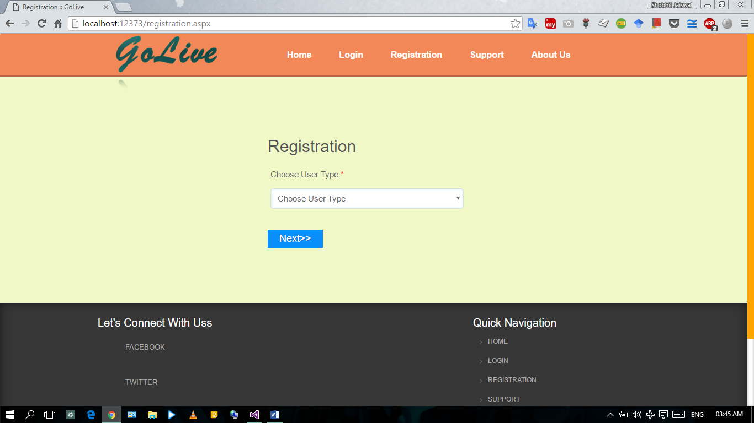
Website’s step to Registration Page:-

Slide 35
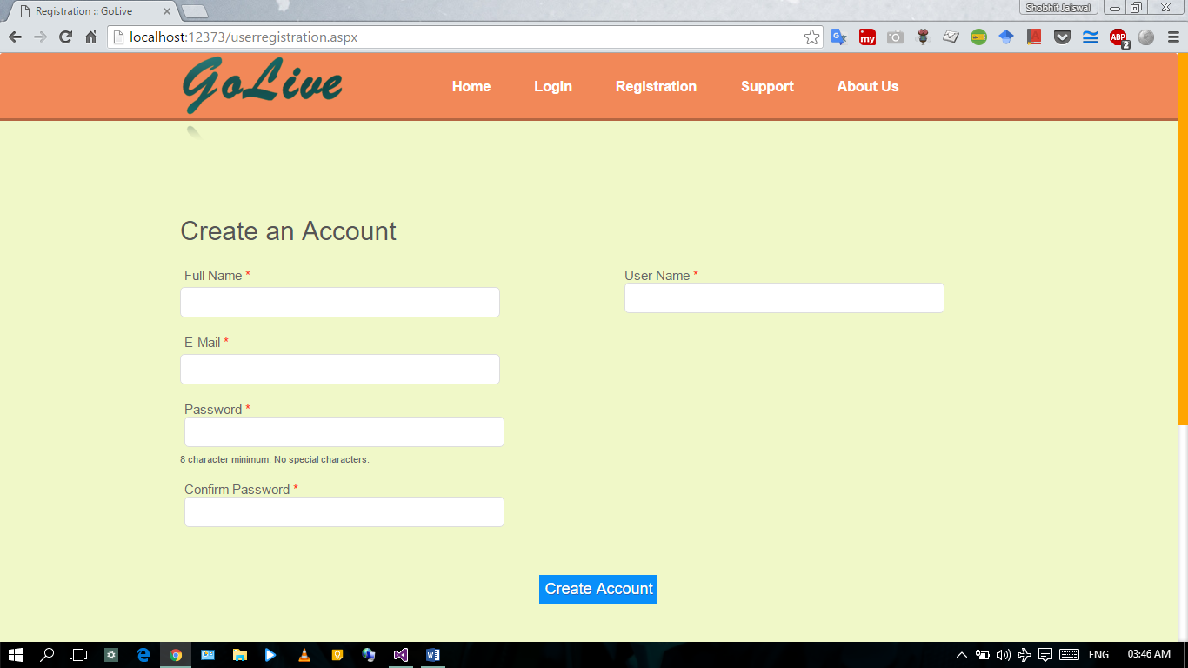
Website’s Registration page for users:-

Slide 36
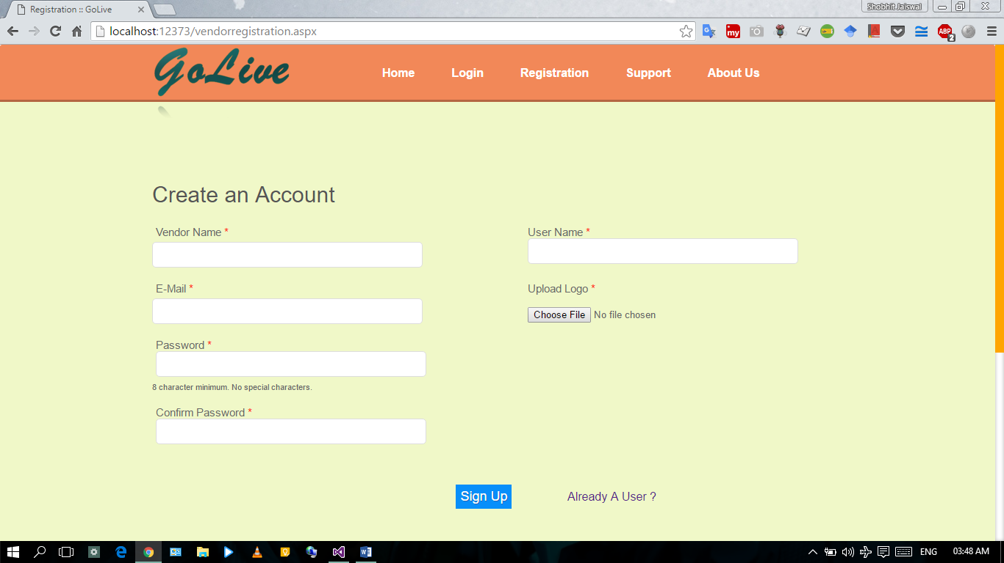
Website’s Registration page for Vendors:-

Slide 37
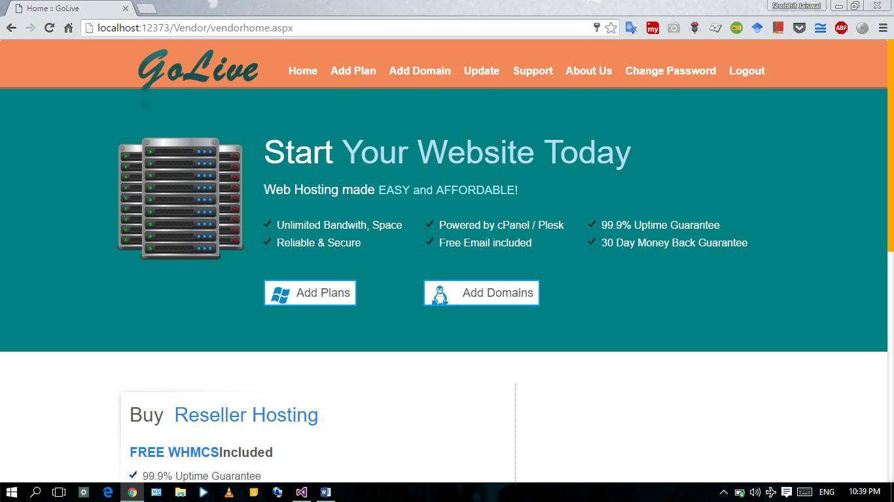
Website’s homepage for Vendor:-

Slide 38
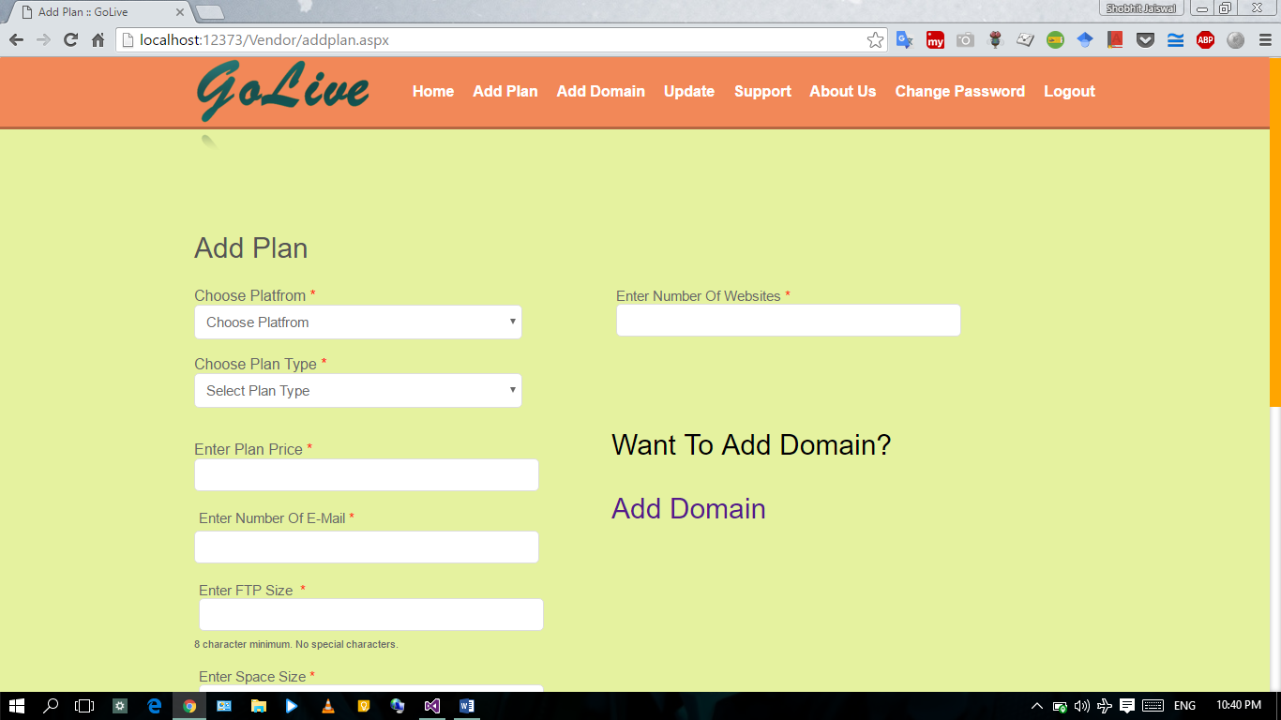
Vendor’s Add Plan Page:-

Slide 39
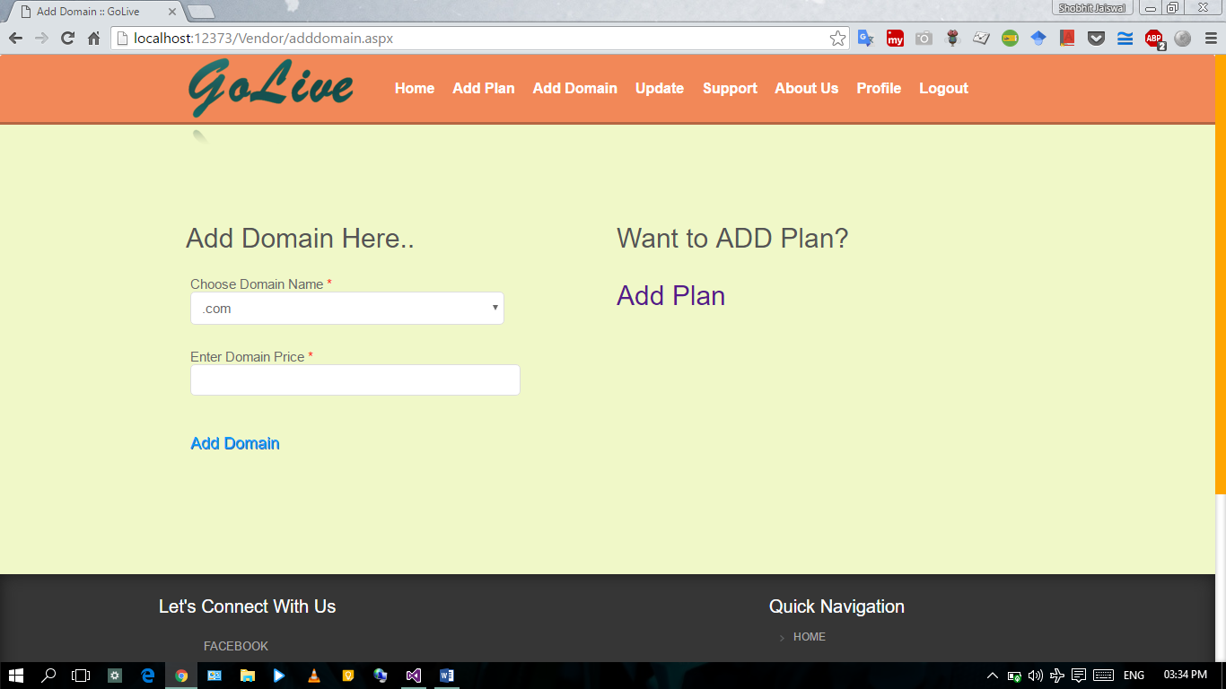
Vendor’s Add Domain Page:-

Slide 40
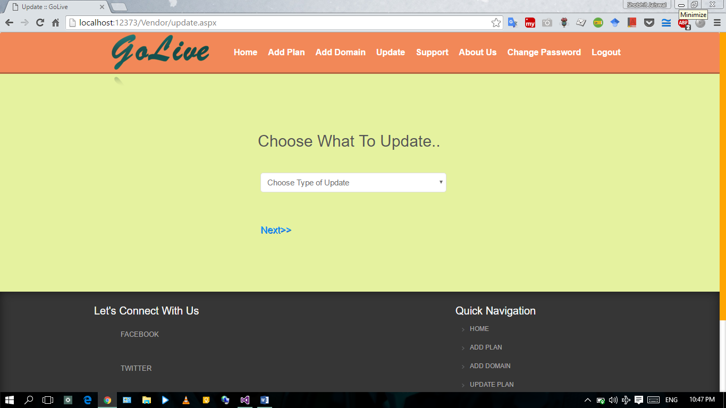
Vendor’s Page for Updating Plans or Domains:-

Slide 41
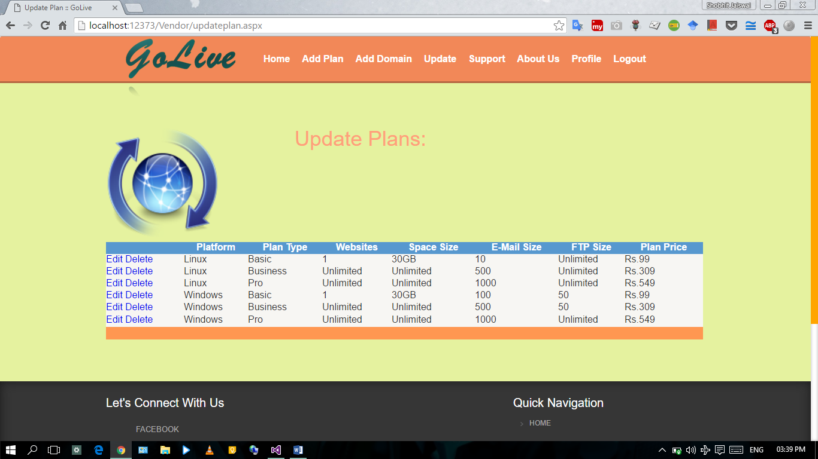
Vendor’s Update Plan Page:-

Slide 42
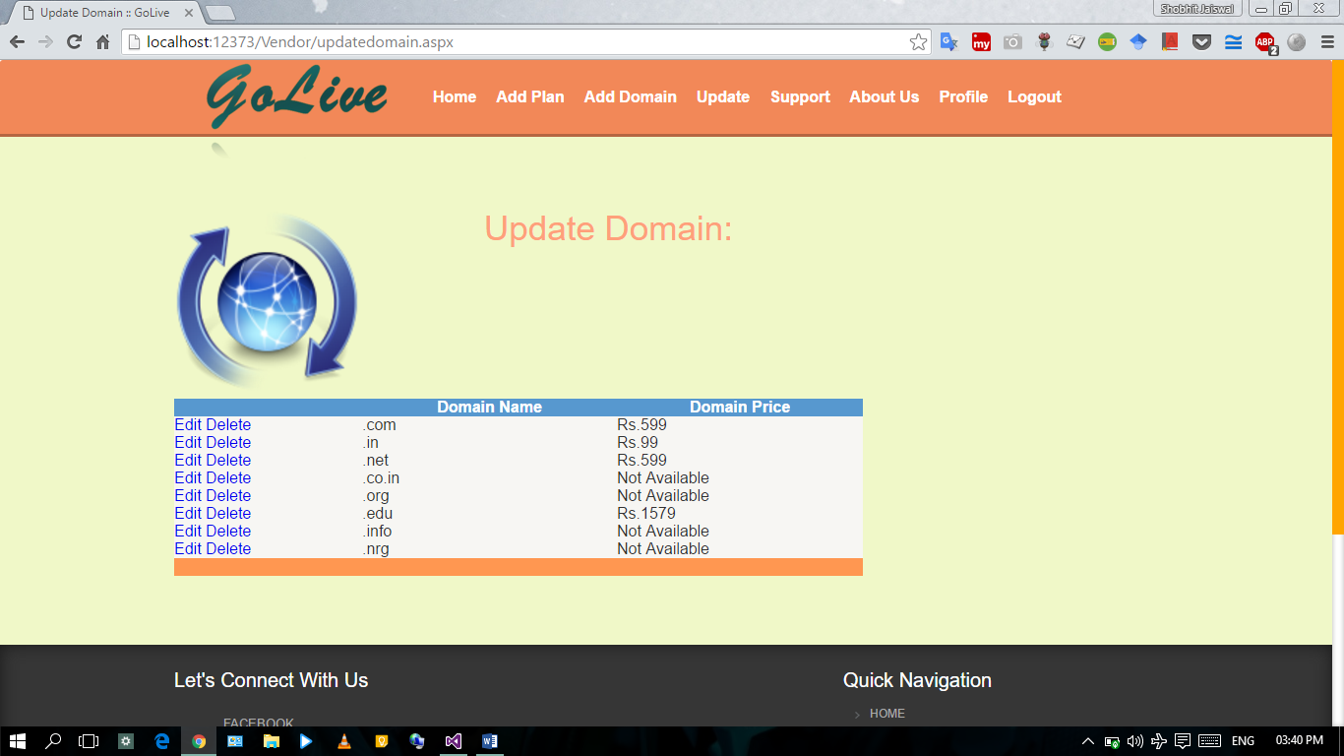
Vendor’s Update Domains Page:-

Slide 43
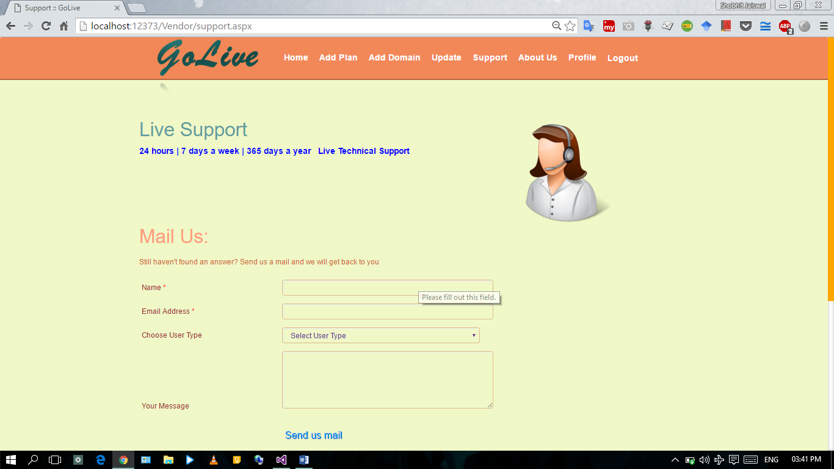
Vendor’s Support Page:-

Slide 44
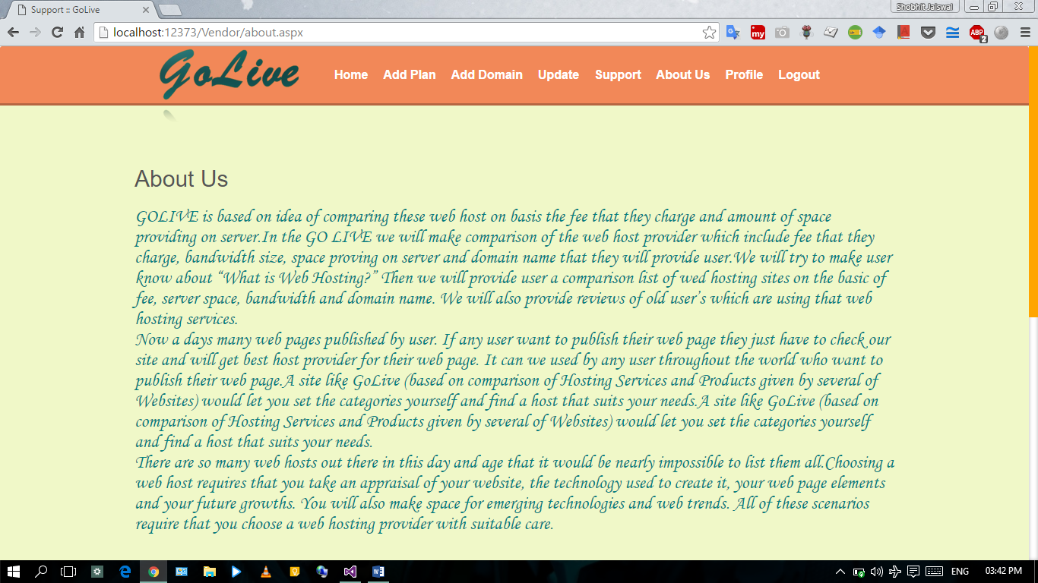
Vendor’s About Us Page:-

Slide 45
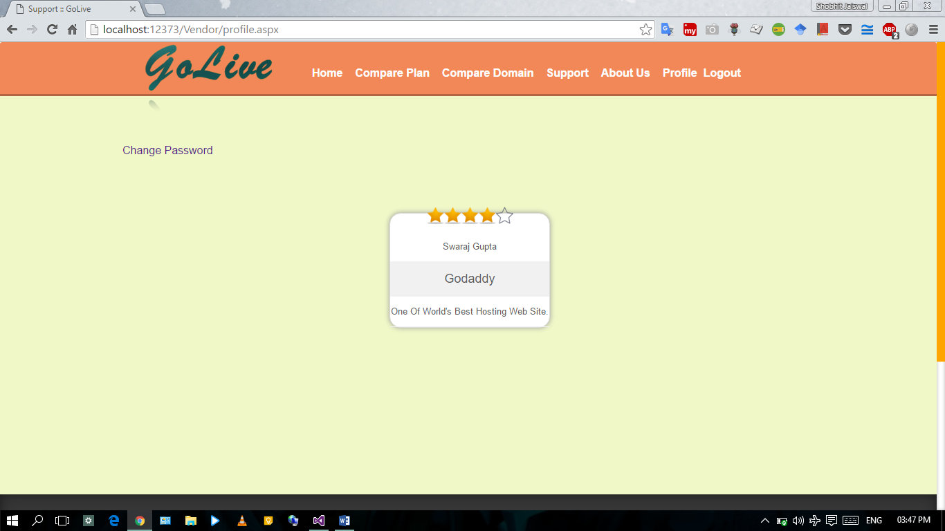
Vendor’s Profile Page:-

Slide 46
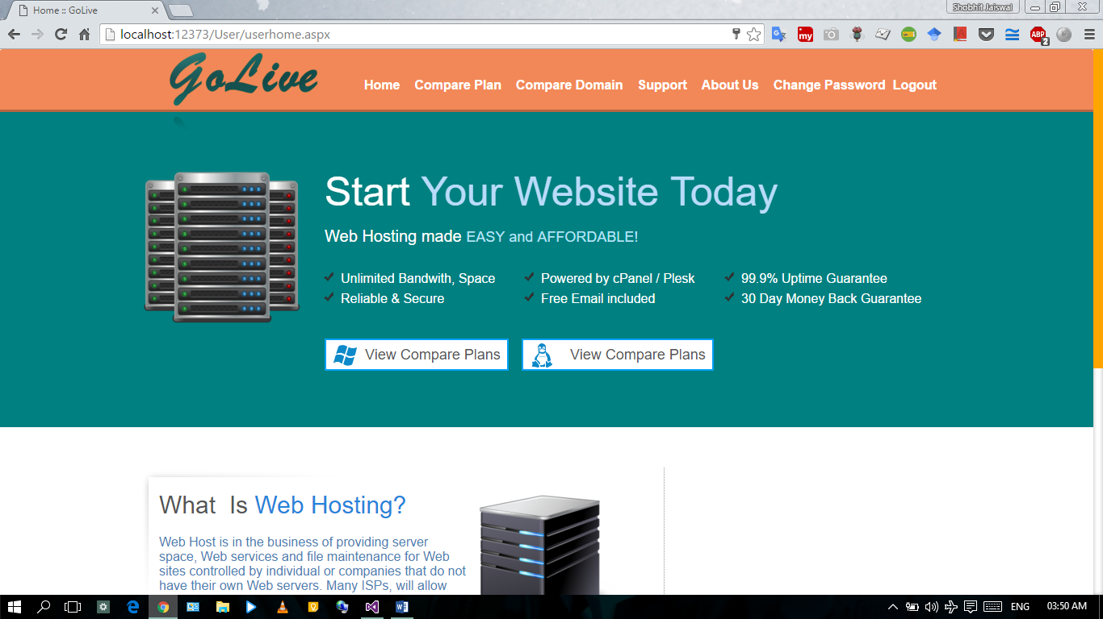
Website’s homepage for user:-

Slide 47
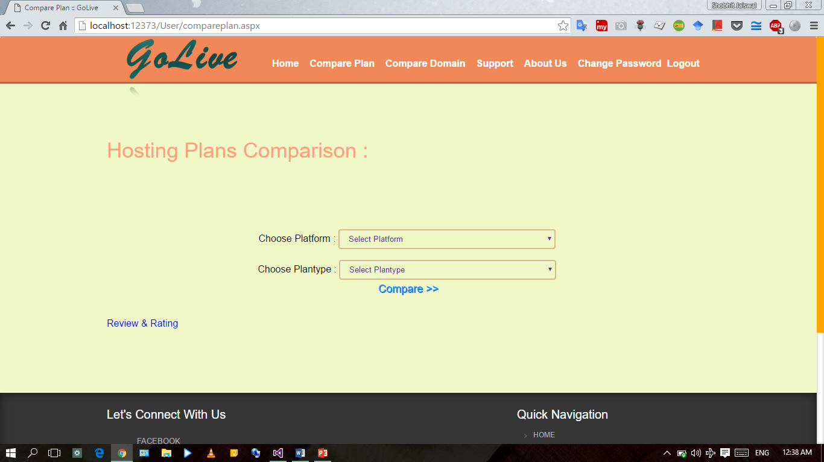
Website’s Hosting Plan Comparison Page for user:-

Slide 48
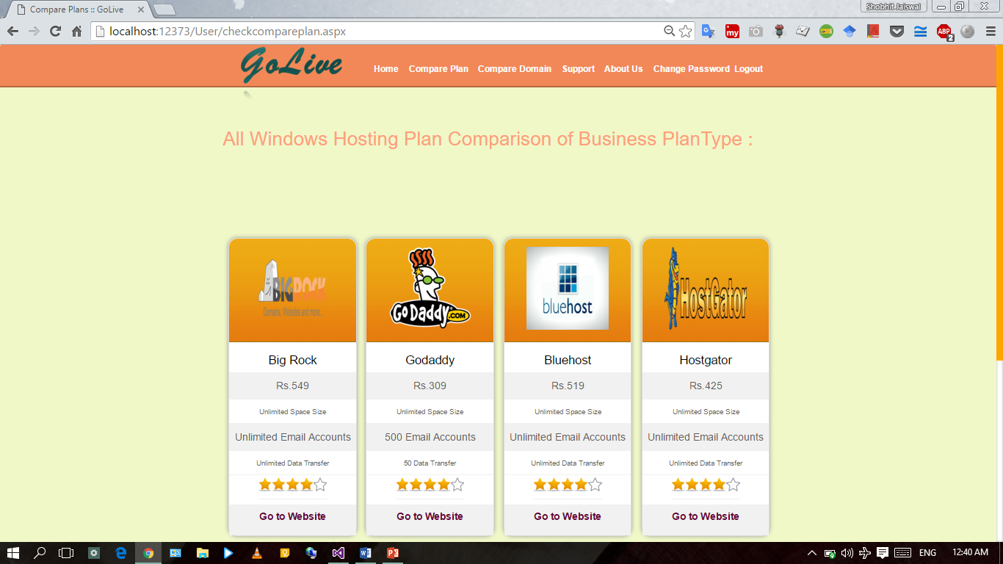
Website’s Hosting Plan Comparison Output Page for user:-

Slide 49
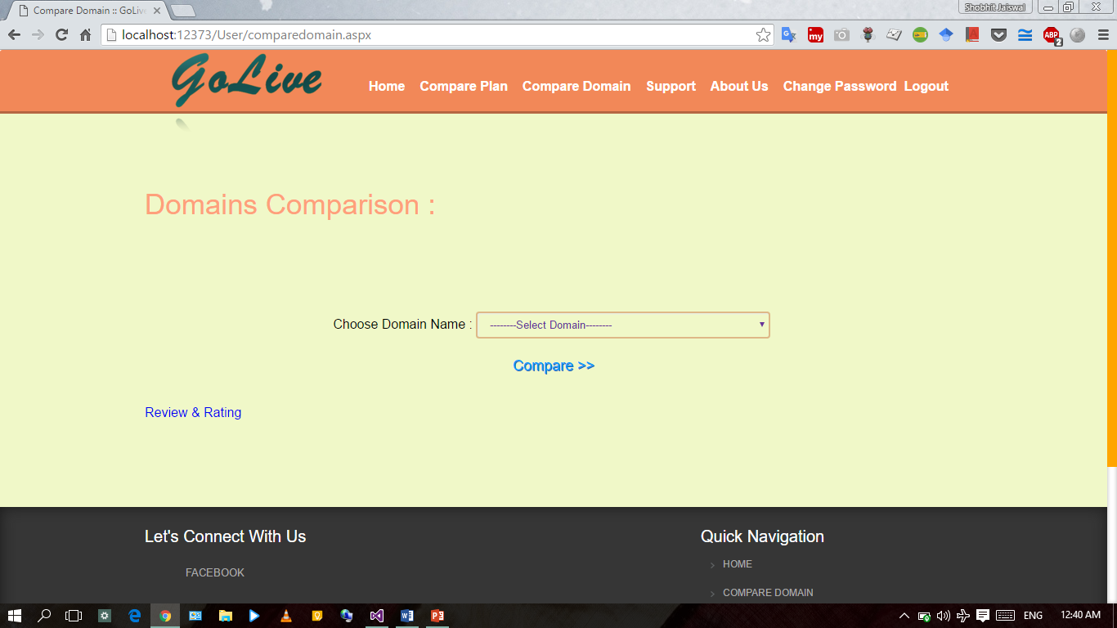
Website’s Domain Comparison Page for user:-

Slide 50
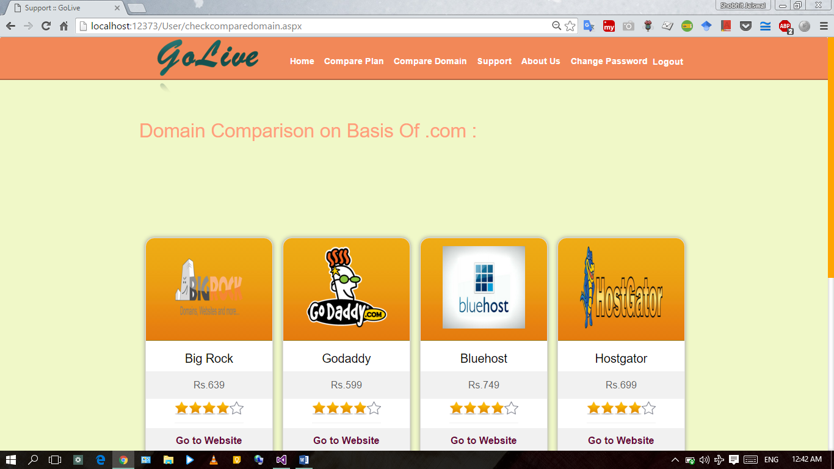
Website’s Domain Comparison Output Page for user:-

Slide 51
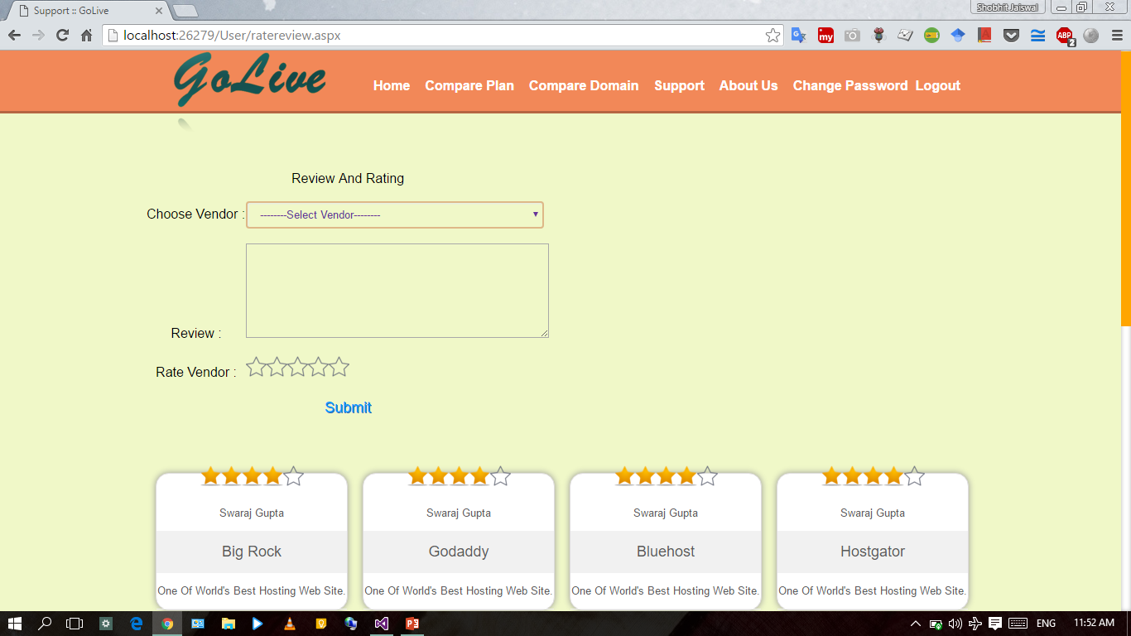
Website’s Review & Rating Page for user:-

Slide 52
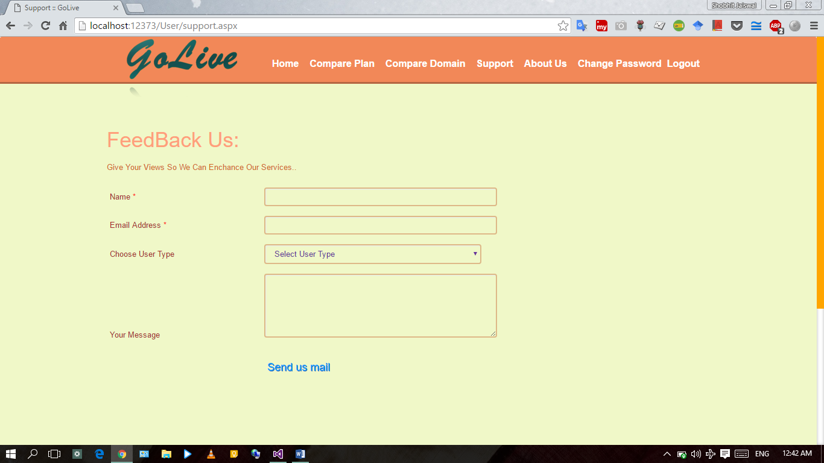
Website’s Support for user:-

Slide 53
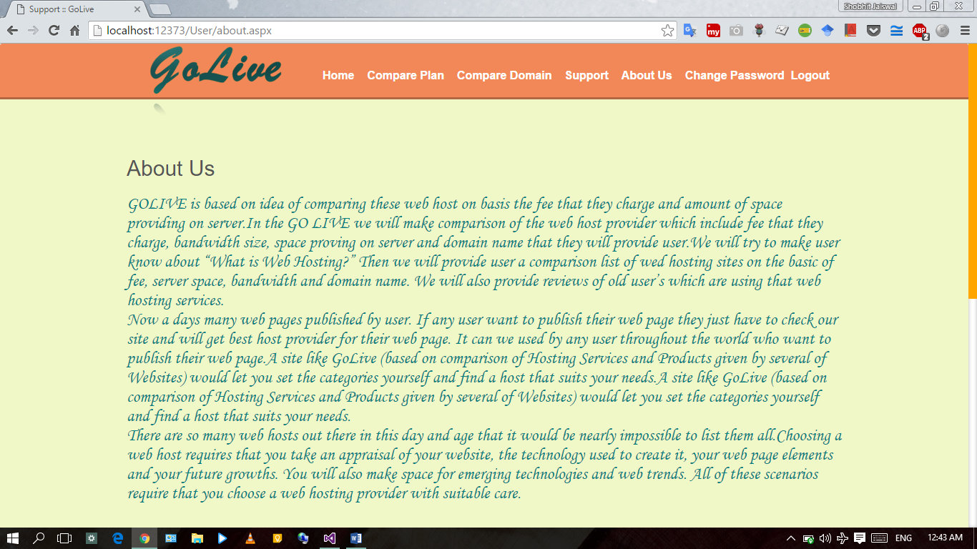
Website’s About Us Page for user:-

Slide 54
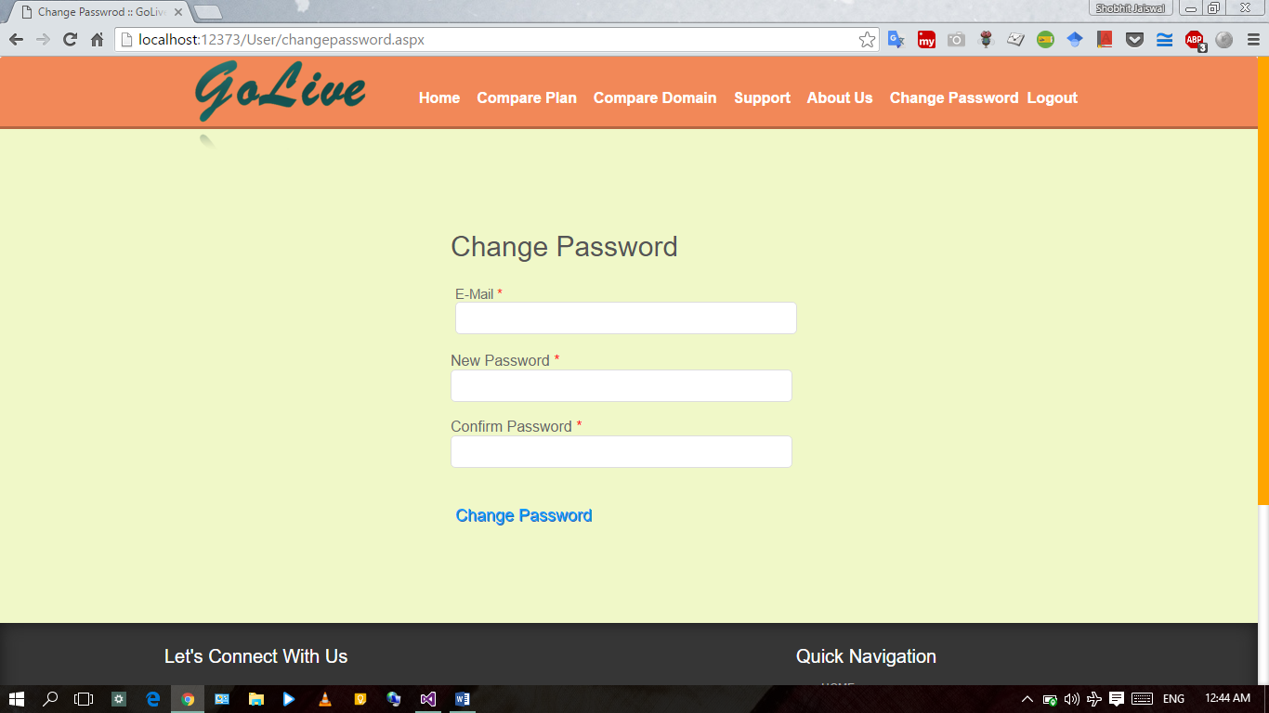
User’s Change Password Page:-

Slide 55
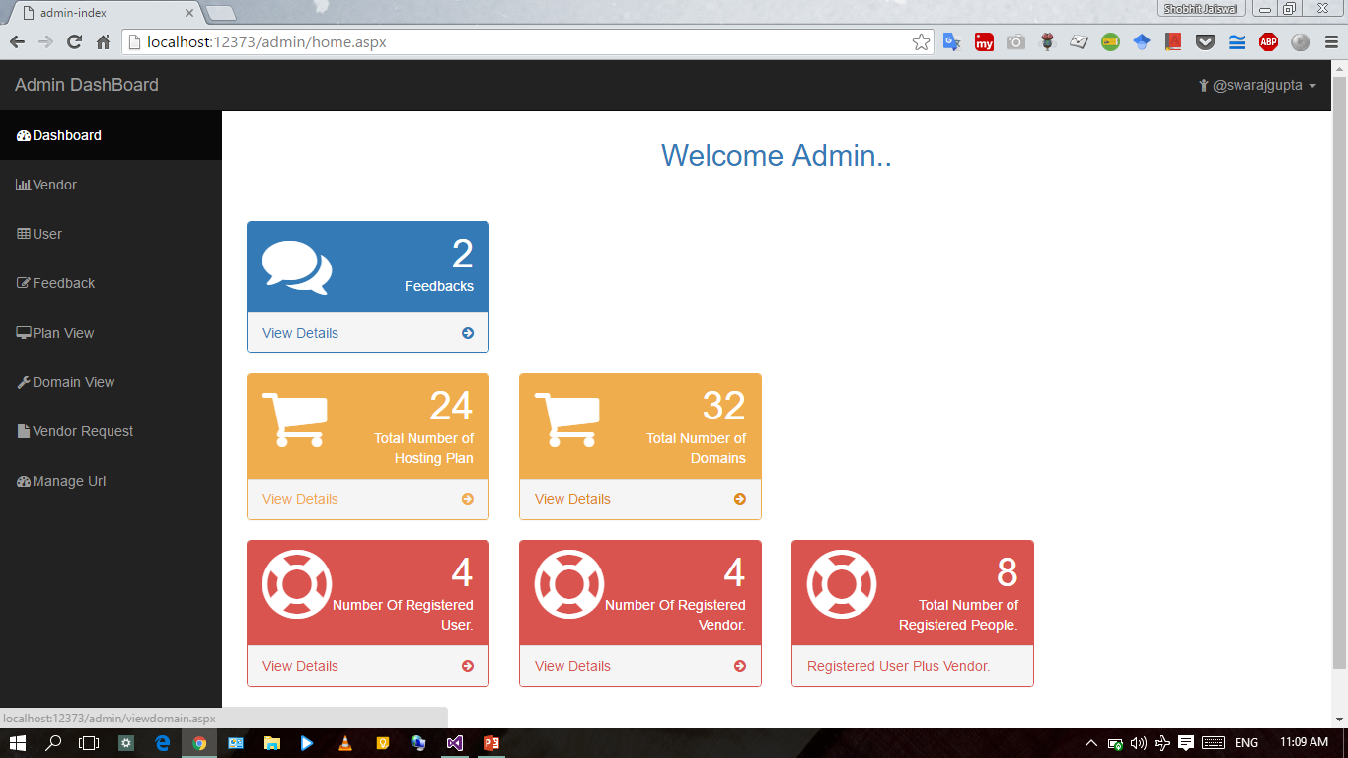
Website’s Admin Home Page:-

Slide 56
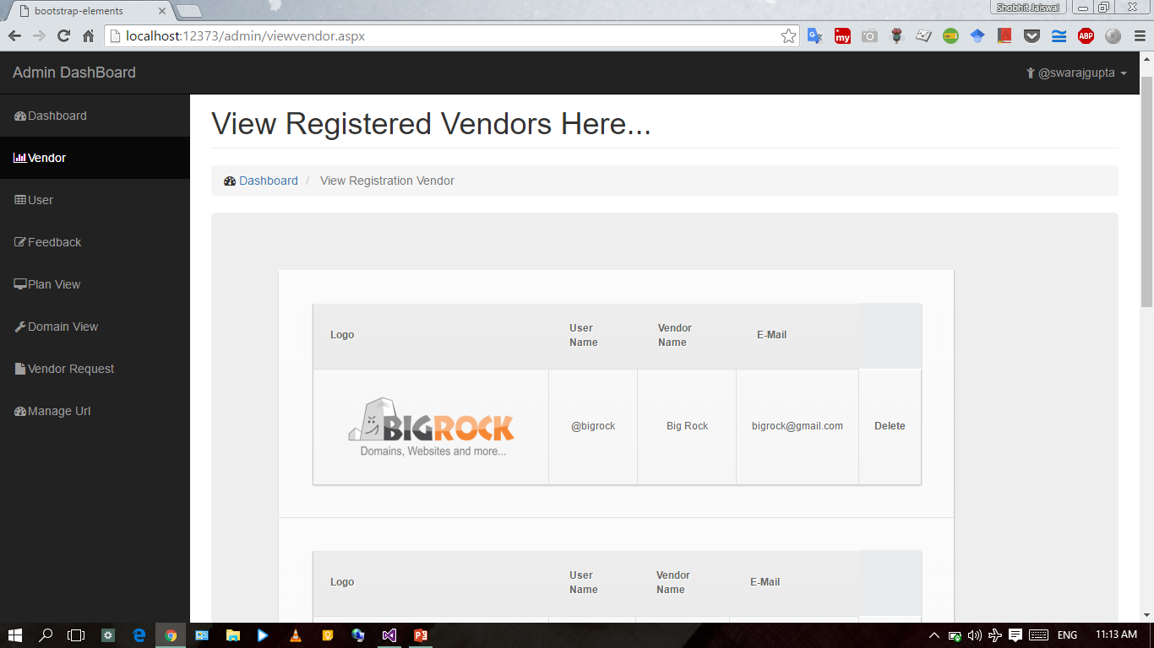
Website’s Admin Page To View All Vendor:-

Slide 57
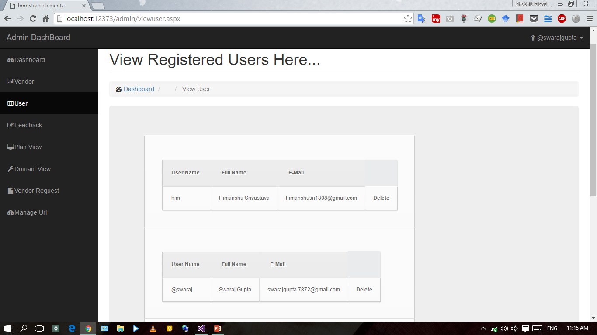
Website’s Admin Page To View All User:-

Slide 58
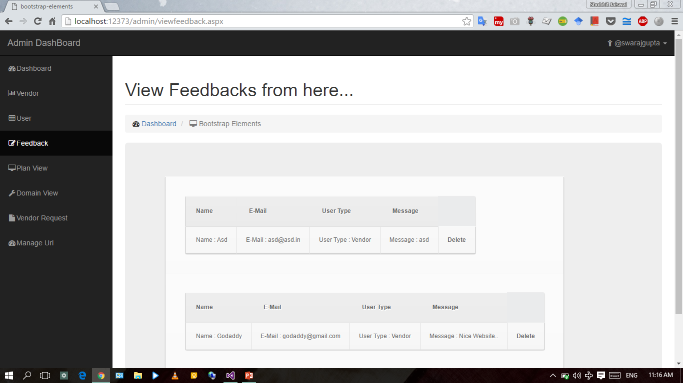
Website’s Admin Page To View Feeedback:-

Slide 59
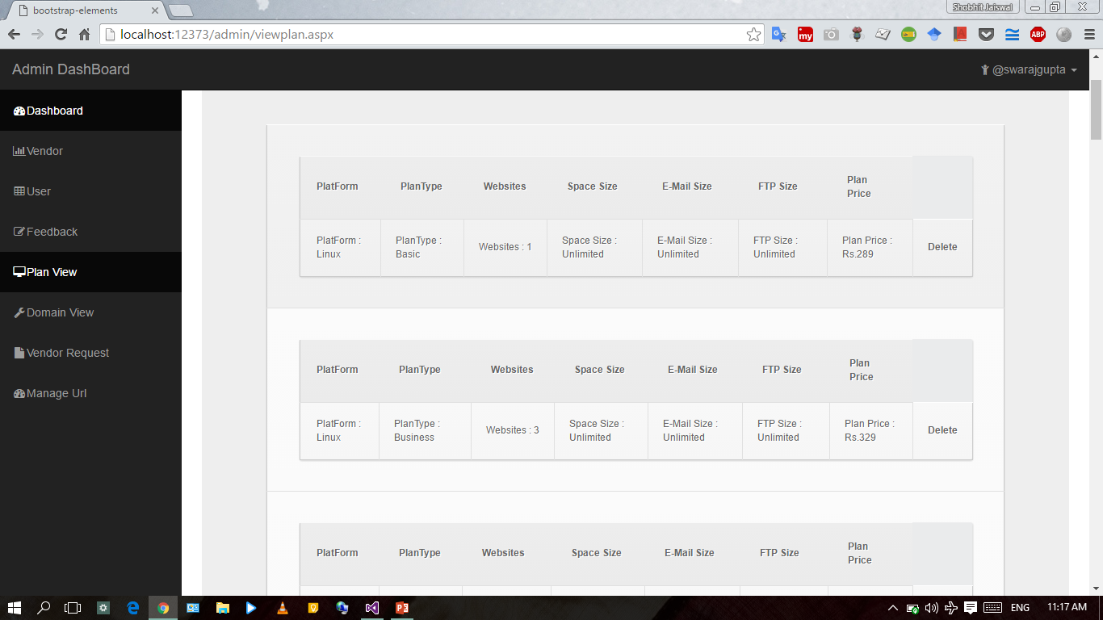
Website’s Admin Page To View Plan List:-

Slide 60
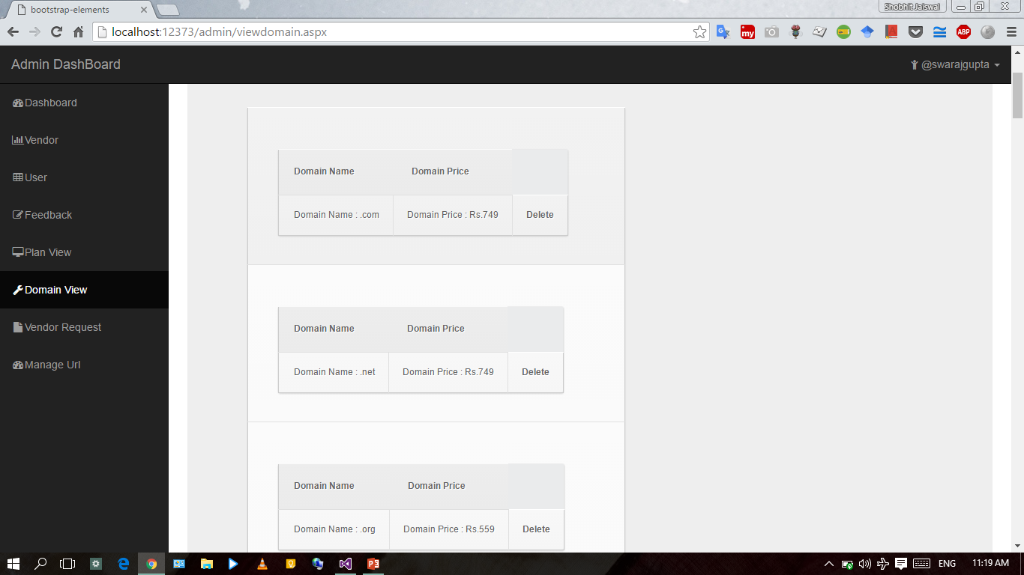
Website’s Admin Page To View Domain List:-

Slide 61
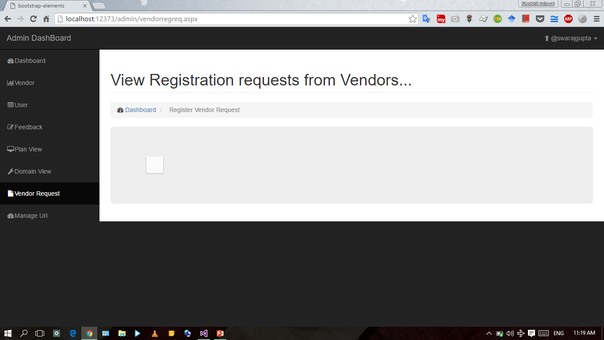
Website’s Admin Page To View Domain List:-

Slide 62
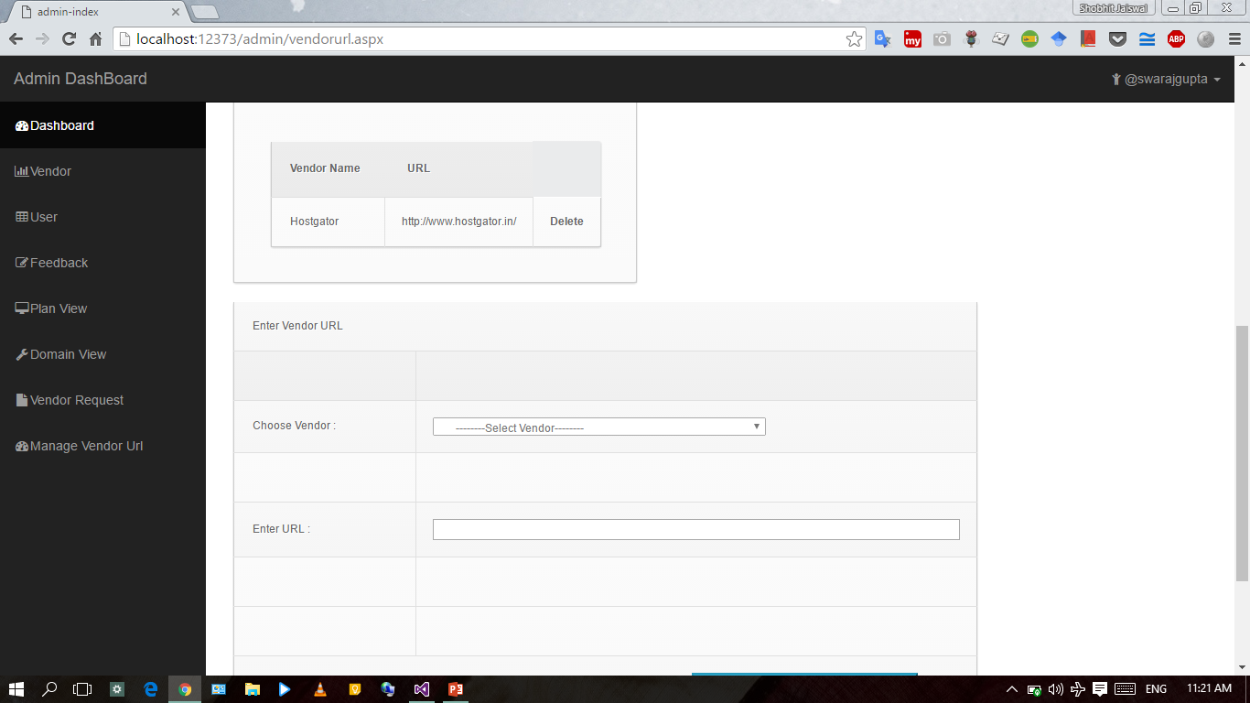
Website’s Admin Page To Manage Vendor’s URL:-

Slide 63
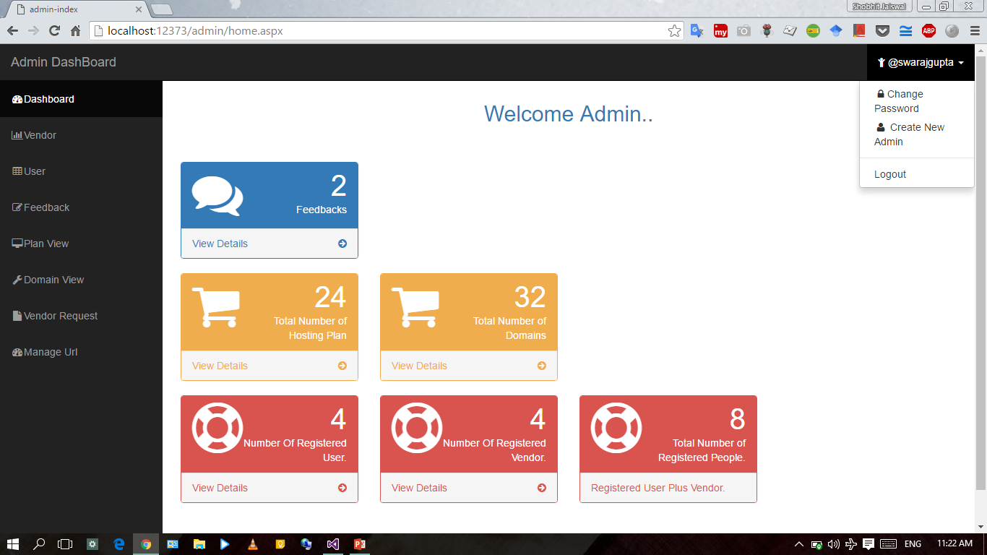
Website’s Admin Page To Manage Profile:-

Slide 64
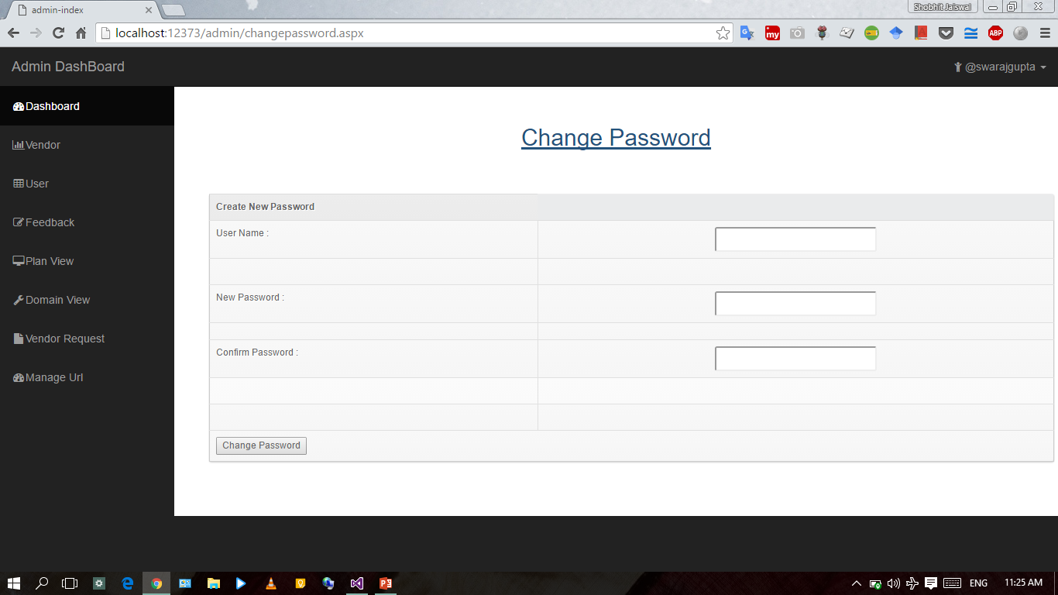
Website’s Admin Page To Change Password:-

Slide 65
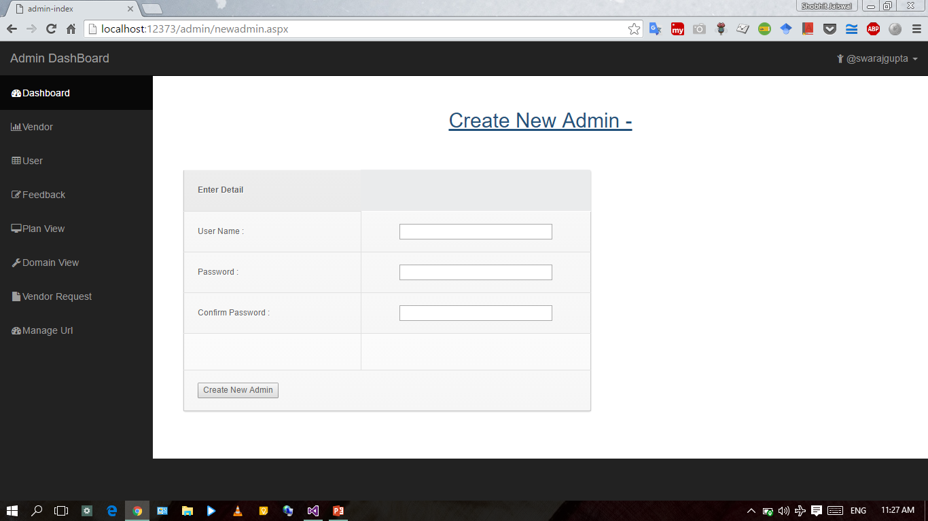
Website’s Admin Page To Create New Admin:-

Slide 66
Conclusion…
There are so many web hosts out there in this day and age that it would be nearly impossible to list them all. A site like GoLive (based on comparison of Hosting Services and Products given by several of Websites) would let you set the categories yourself and find a host that suits your needs.

Slide 67
References
Books:
Software Requirements By Karl Wiegers
Requirements Specification By Stephen Withal
Websites:
http://www.projectguru.com
http://www.vceit.com
http://www.csis.pac.edu.com

